Slide 1


Strategic Planning Sessions
By Shay Walker-Wilson

Slide 2
Getting Started
Begin where you and those involved or affected by currently are
Have a compelling reason
There is no substitute for leadership
Be attentive and tailor the process to the situation at hand according to the needs
Big innovation = communication, collaboration, and community working together
Attention and Commitment are key resources
Do not be afraid of surprises

Slide 3

Great Strategic Sessions Do Not Happen by Accident
Regularly Scheduled
Not Operations Focused
Leadership Engaged
Ample Resources

Slide 4

Defining The Process
Determine the right attendees
Creating an effective information-gathering process
Have a clear purpose & agenda based on the organization’s Goals

Slide 5

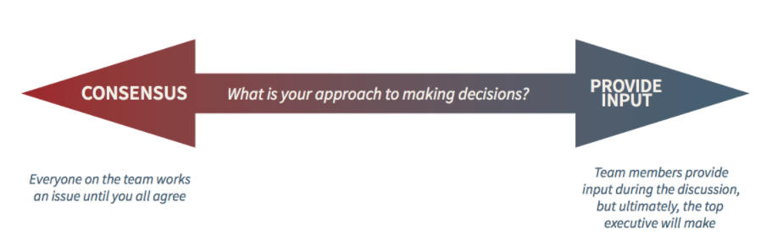
Session Preparation
Schedule a session time and collect the necessary data
Create an Agenda
Make the First Meeting a Success
Establish the right Tone
- Adopt a common decision-making process

Slide 6


The Session
Encourage Candid Dialogue
View with a Critical Spotlight
Use Facilitation Techniques
Take Notes
Stay On Track

Slide 7

Follow- Up
Action follows Decision
Think Critically About the Metrics
Share/Distribute Notes
Create a Check-up Schedule

Slide 8

Maintaining Momentum
Sustainability is About Culture Change
Replicable Process

Slide 9
References
Bryson, J. M. (2018). Part Three: Managing the Process and Getting Started with Strategic Planning. In Strategic planning for public and nonprofit organizations: For public and nonprofit organizations, a guide to strengthening and sustaining organizational achievement (5th ed., pp. 351-400). Hoboken, NJ: Wiley.
Jackson, T. (2021, January 04). The 8-part guide to leading a successful strategy meeting. Retrieved February 13, 2021, from https://www.clearpointstrategy.com/strategy-meeting-guide/
Kelly, M. (2017, August 15). 5 ways to STRATEGICALLY plan your strategic planning meeting. Retrieved February 14, 2021, from https://productiveleaders.com/strategic-planning-meeting/
Neal, P. (2021, February 2). Change: Strategically Thinking about the Process. Lecture presented at Strategic Management BUS 691 in Cairn University, Langhorne.
Neal, P. (2021, January 25). Impacting the Mission: Strategic Planning. Lecture presented at Strategic Management BUS 691 in Cairn University, Langhorne.

